Slide 1
Bayesian integrated population modeling using JAGS Estimation of survival probabilities using capture-recapture data
Notes:
A few words to tell how we met back in Montpellier > 15 years ago Marc, Michael and I; Roger/Jean-Do in common, we're like cousin; introduce Maud

Slide 2

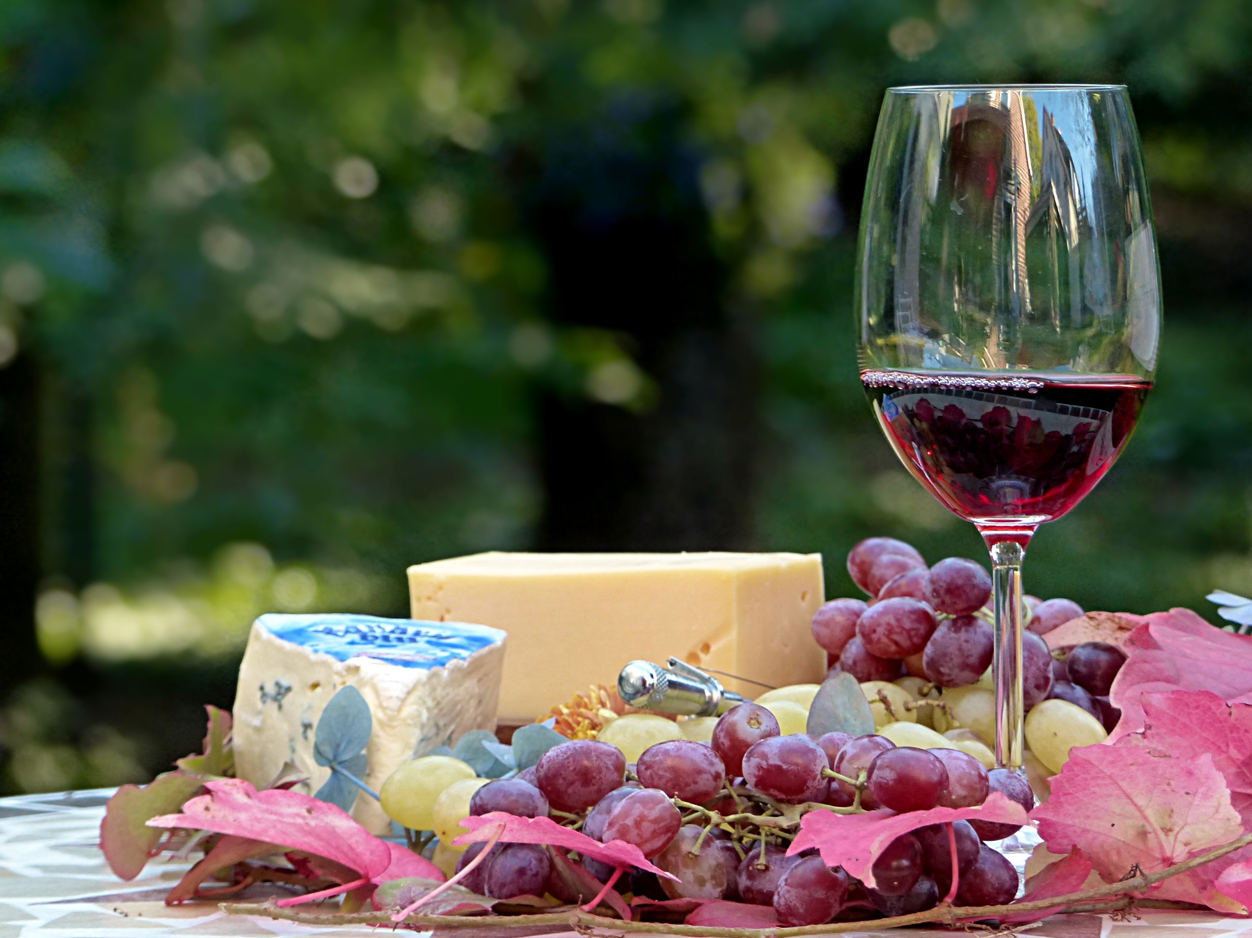
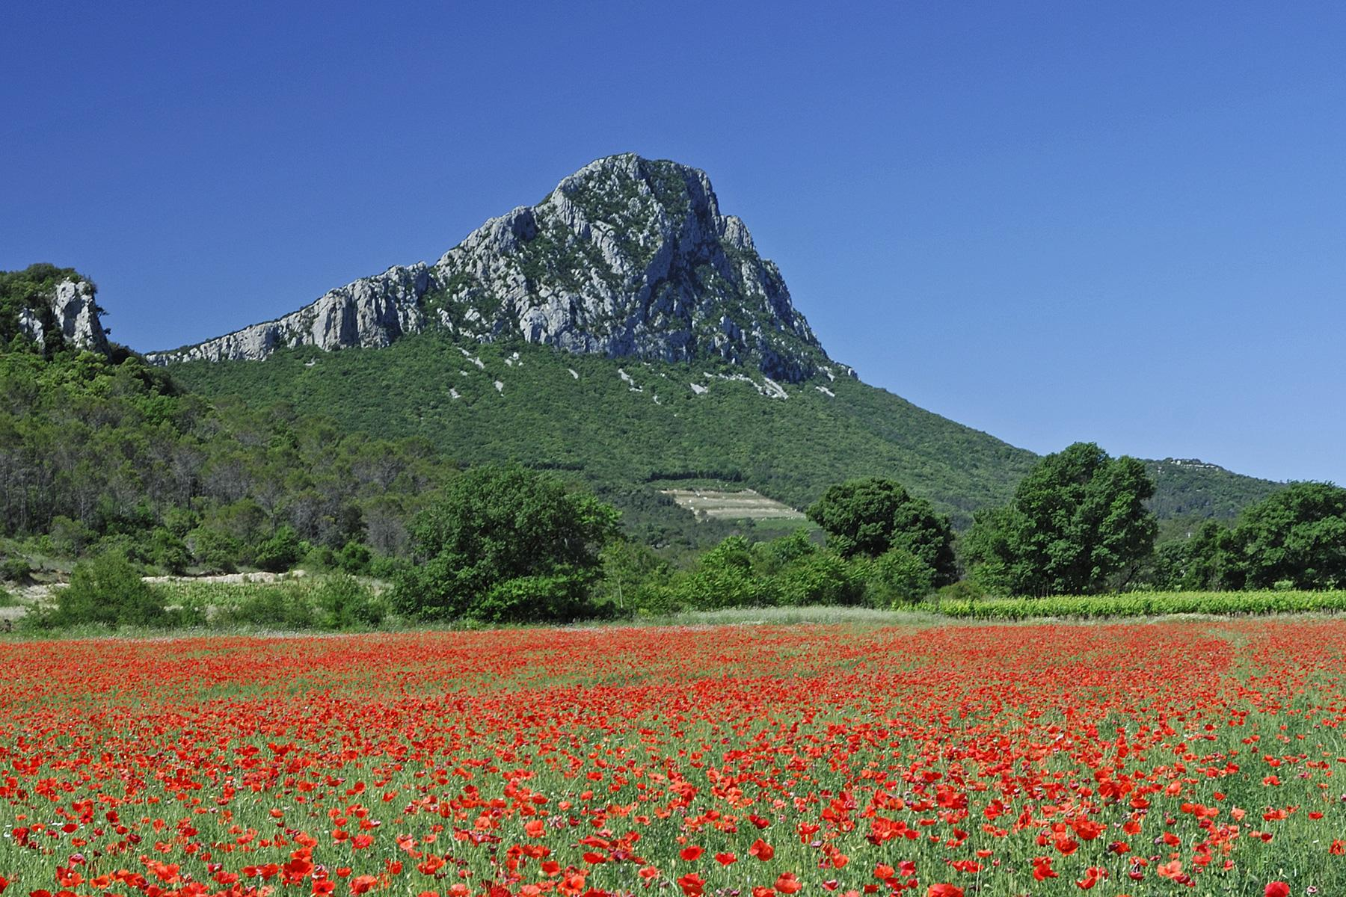
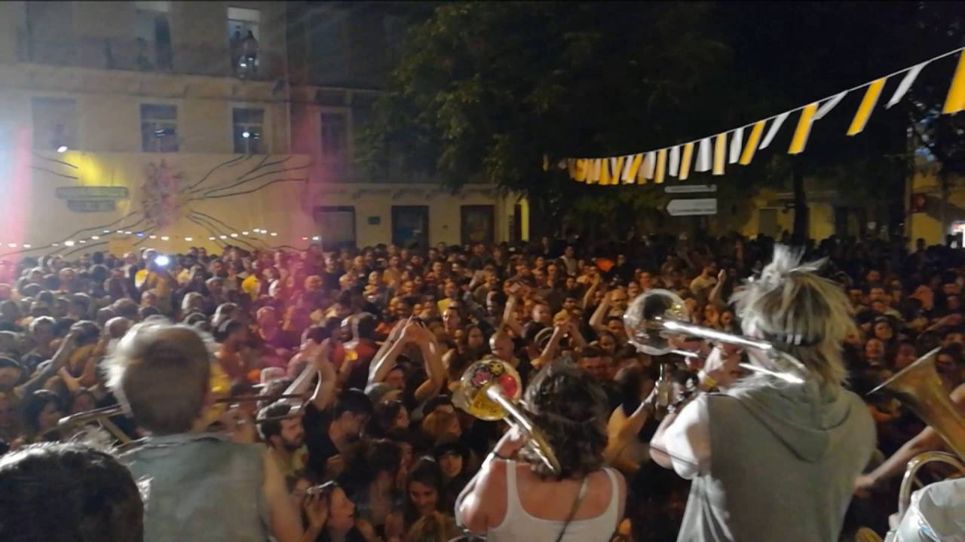
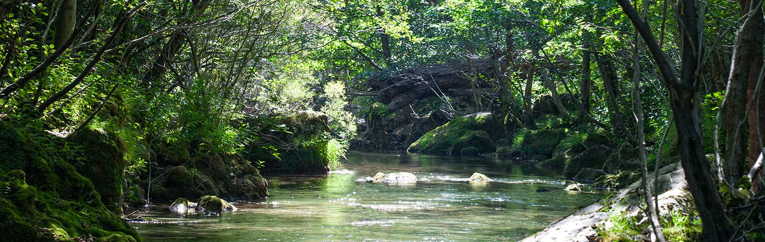

Montpellier and its charms

Slide 3


Slide 4
It is fairly easy to estimate survival, or is it?
In principle:
Follow individuals across time
Count individuals at time t say C_{t}
Assess how many of them are still alive after time Δt say L_{t+Δt}
Survival probability is then
Notes:
Knowing survival rates is important for studies in different fields. You know this better than me, and I think that you have decided to join this course because you are aware of this.
The principle is easy: give an example.
Big problem: some individuals are overseen. This results in an underestimation of the survival rate.

Slide 5
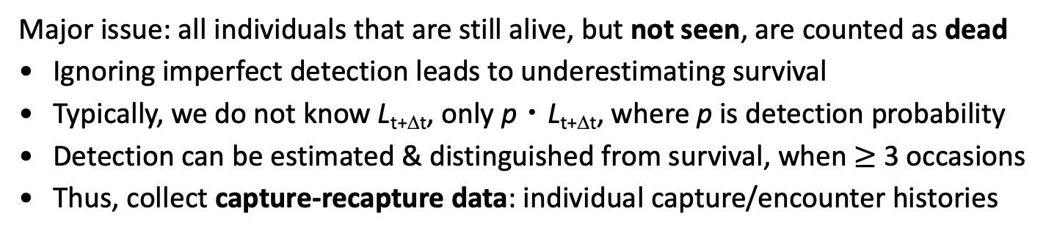
It is fairly easy to estimate survival, or is it?
In principle:
Follow individuals across time
Count individuals at time t say C_{t}
Assess how many of them are still alive after time Δt say L_{t+Δt}
Survival probability is then
Major issue: all individuals that are still alive, but not seen, are counted as dead
Ignoring imperfect detection leads to underestimating survival
Typically, we do not know L_{t+Δt}, only p・L_{t+Δt}, where p is detection probability
Detection can be estimated & distinguished from survival, when $≥$ 3 occasions
Thus, collect capture-recapture data: individual capture/encounter histories
Notes:
Knowing survival rates is important for studies in different fields. You know this better than me, and I think that you have decided to join this course because you are aware of this.
The principle is easy: give an example.
Big problem: some individuals are overseen. This results in an underestimation of the survival rate.

Slide 6
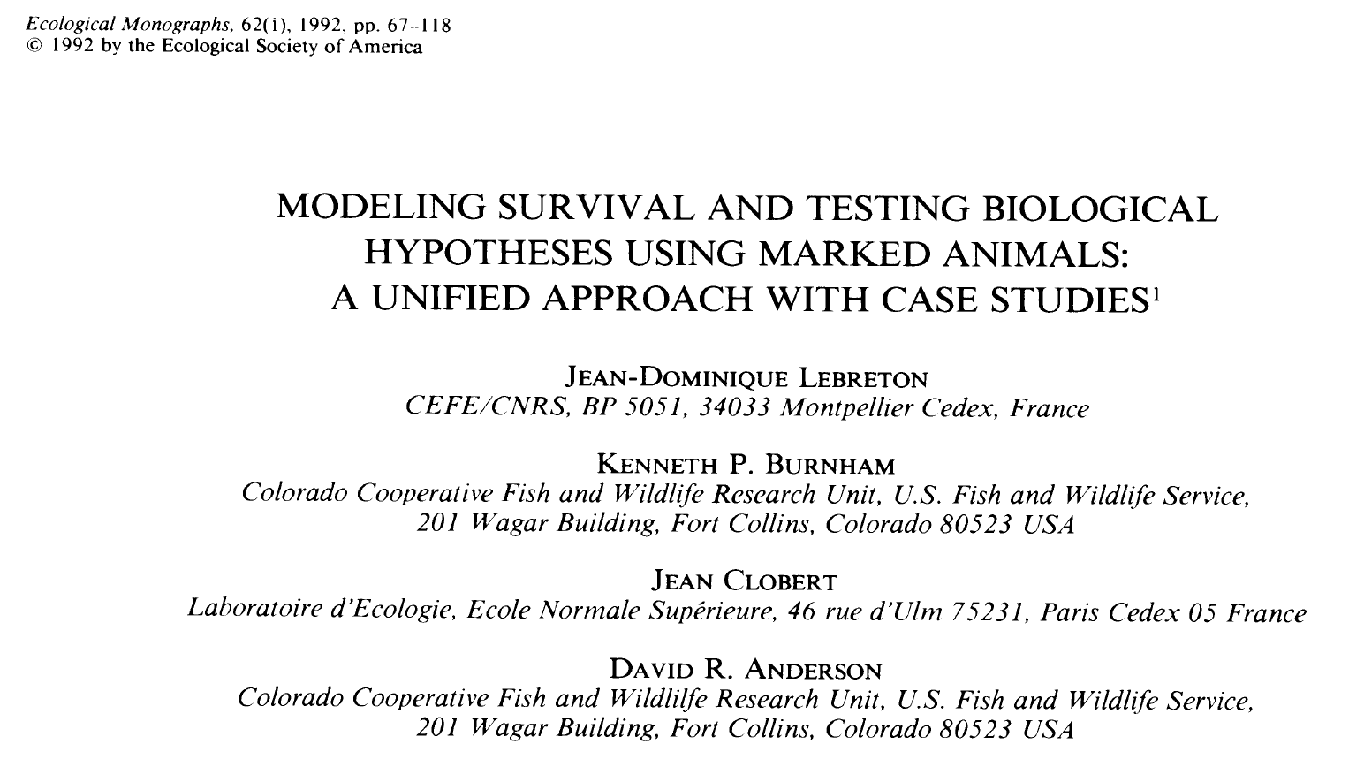


Slide 7
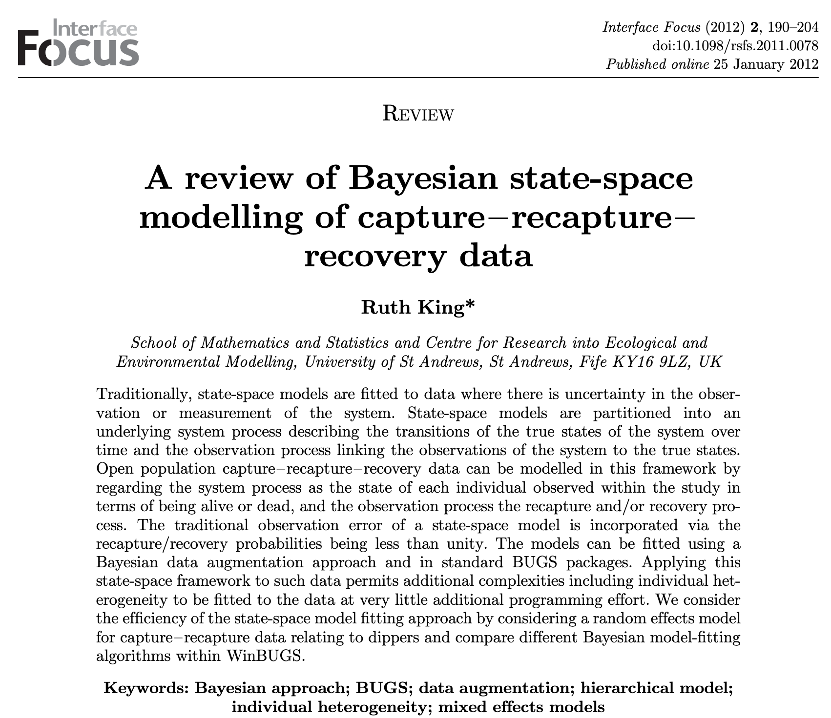

Slide 8
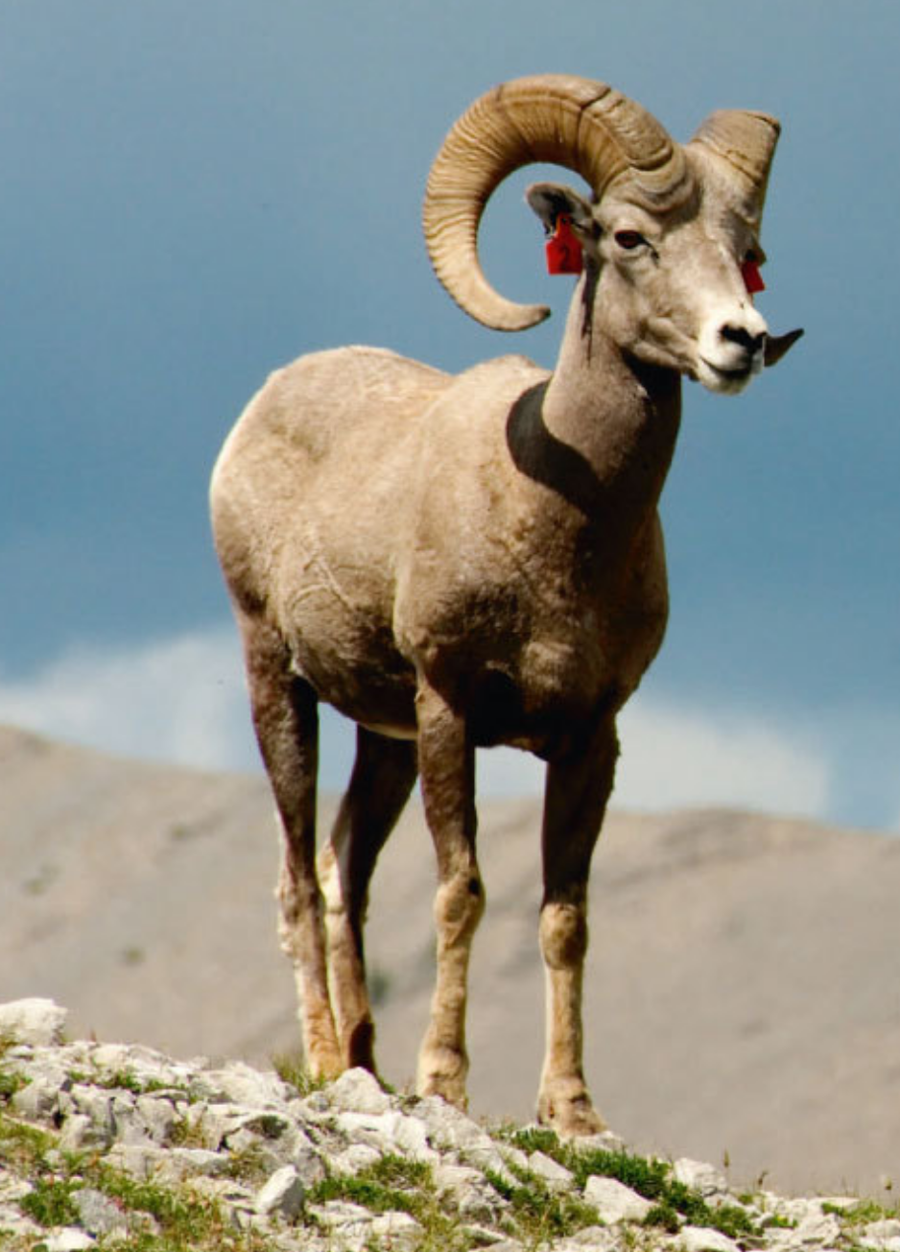
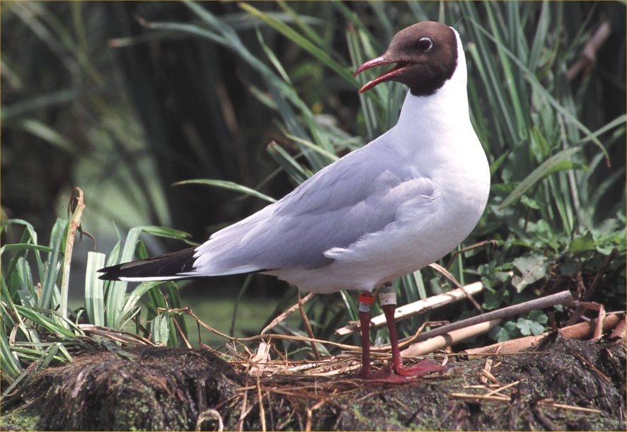
Marking, recaptures and resightings
Artificial marks
Notes:
a key for estimating survival is that we have to follow individuals across time. Thus we have to know and be able to distinguish individuals.
This ususally means that we mark individuals with rings, wingmarks or similar – sometimes natural marks or genetic methods can be used.
Black-headed gulls
Bighorn sheep
Lynx

Slide 9
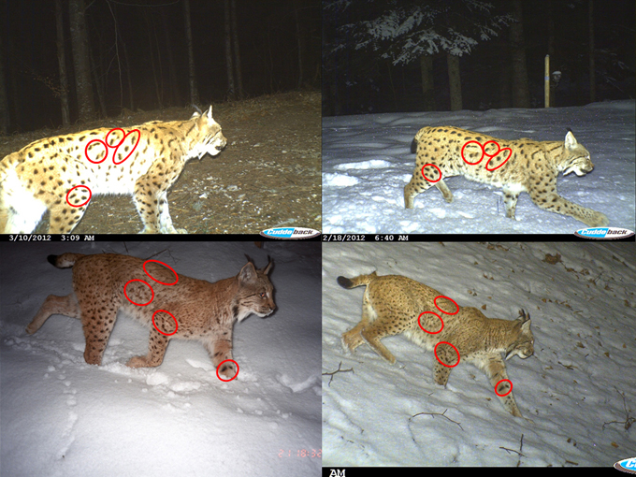
Marking, recaptures and resightings
Artificial marks
Natural marks
Notes:
a key for estimating survival is that we have to follow individuals across time. Thus we have to know and be able to distinguish individuals.
This ususally means that we mark individuals with rings, wingmarks or similar – sometimes natural marks or genetic methods can be used.
Black-headed gulls
Bighorn sheep
Lynx

Slide 10
Marking, recaptures and resightings
Artificial marks
Natural marks
… also genetic & acoustic marks
Notes:
a key for estimating survival is that we have to follow individuals across time. Thus we have to know and be able to distinguish individuals.
This ususally means that we mark individuals with rings, wingmarks or similar – sometimes natural marks or genetic methods can be used.
Black-headed gulls
Bighorn sheep
Lynx

Slide 11
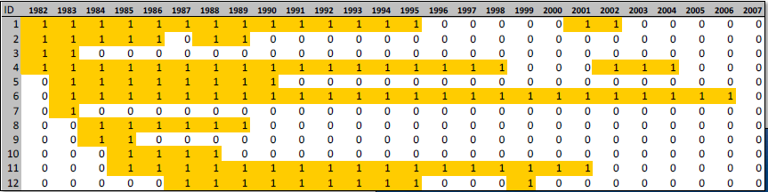
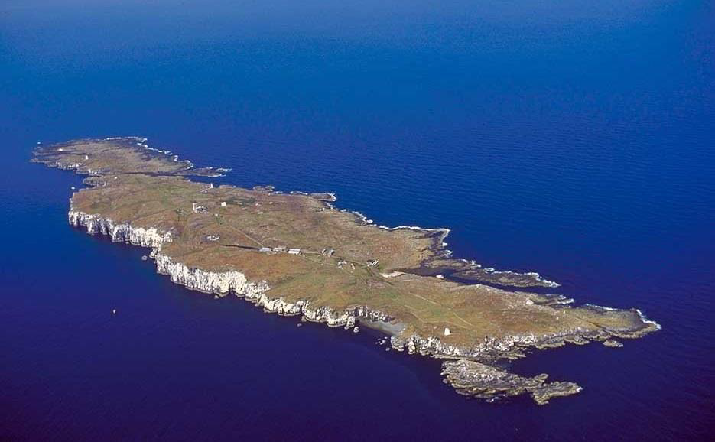
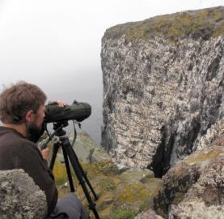
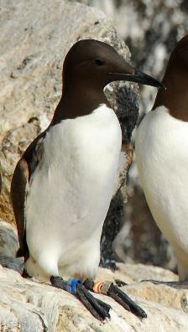
Individual capture histories – longitudinal monitoring
S. Wanless, J. Lahoz-Monfort
https://bit.ly/390ABBu
Notes:
Courtesy Jose Lahoz-Monfort & Sarah Wanless
Common guillemots
Isle of May in Scotland
https://bit.ly/390ABBu

Slide 12
Individual capture history: result of two processes
State process
Alive
Dead
Stochastic process
Deterministic process
Notes:
12
The data you wish you had.

Slide 13
Individual capture history: result of two processes
State process
Alive
Dead
Actual states: AAAADDD
Stochastic process
Deterministic process
Notes:
13
AAAADDD
Stochastic vs. Deterministic links

Slide 14
Individual capture history: result of two processes
State process
Alive
Dead
Seen
Not seen
Observation process
Stochastic process
Deterministic process
Notes:
14
The data you actually obsrve, you actually collect in the field.
Note that at the occasion of release, there is no recapture possible and the state „alive“ is sure without uncertainty

Slide 15
Individual capture history: result of two processes
State process
Alive
Dead
Seen
Not seen
Observation process
Actual states: AAAADDD
Observations are: 1010000
Stochastic process
Deterministic process
Notes:
15
Individual capture history is 1010000

Slide 16
State-space likelihood to analyse CR data
1. State process corresponding to survival
where,
z_{i,t}: latent state indicating whether individual i is alive at time t (z = 1) or dead (z = 0)
φ_{i,t}: survival probability for individual i from time t to t+1
Notes:
Note that at the occasion of release, there is no recapture possible and the state „alive“ is sure without uncertainty
Decomposer les Bernoulli.

Slide 17
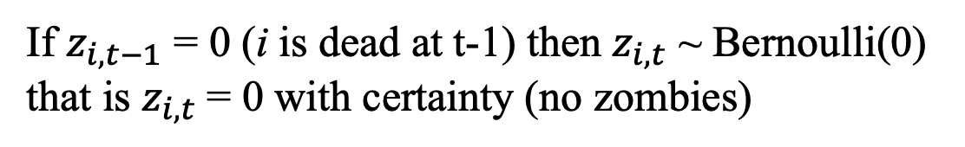
State-space likelihood to analyse CR data
1. State process corresponding to survival
where,
z_{i,t}: latent state indicating whether individual i is alive at time t (z = 1) or dead (z = 0)
φ_{i,t}: survival probability for individual i from time t to t+1
If $z_{i,t−1}$ = 0 (i is dead at t-1) then $z_{i,t}$ ~ Bernoulli(0)
that is $z_{i,t}$= 0 with certainty (no zombies)
Notes:
Note that at the occasion of release, there is no recapture possible and the state „alive“ is sure without uncertainty
Decomposer les Bernoulli.

Slide 18
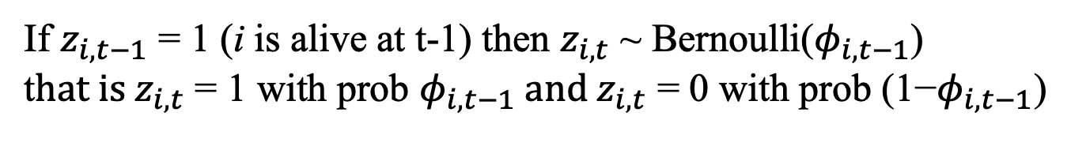
State-space likelihood to analyse CR data
1. State process corresponding to survival
where,
z_{i,t}: latent state indicating whether individual i is alive at time t (z = 1) or dead (z = 0)
φ_{i,t}: survival probability for individual i from time t to t+1
If $z_{i,t−1}$ = 1 (i is alive at t-1) then $z_{i,t}$ ~ Bernoulli($φ_{i,t−1}$)
t$hat is z_{i,t}$ = 1 with prob $φ_{i,t−1} and{ z}_{i,t}\text{ = 0 }\text{with} \text{prob}\text{ (1−}φ_{i,t−1}$)
Notes:
Note that at the occasion of release, there is no recapture possible and the state „alive“ is sure without uncertainty
Decomposer les Bernoulli.

Slide 19
State-space likelihood to analyse CR data
1. State process corresponding to survival
where,
z_{i,t}: latent state indicating whether individual i is alive at time t (z = 1) or dead (z = 0)
φ_{i,t}: survival probability for individual i from time t to t+1
2. Observation process corresponding to detection
where,
y_{i,t}: is the event of capture for individual i at time t (y = 1 if detected, 0 otherwise)
p_{i,t}: recapture probability for individual i at time t
Royle 2008, Gimenez et al. 2007
Notes:
Note that at the occasion of release, there is no recapture possible and the state „alive“ is sure without uncertainty
Have the attendees decompose the Bernoulli for the detection process

Slide 20
Data
Parameters
Notes:
20
You see that our survival and detection parameters are individual and time specific. Let‘s put them in tables or matrices for convenience.

Slide 21
Data
Parameters
Notes:
21
phi(1,2) is the survival probability for individual 1 between occasion 2 and 3.
This parameter is active on an interval.

Slide 22
Data
Parameters
Notes:
22

Slide 23
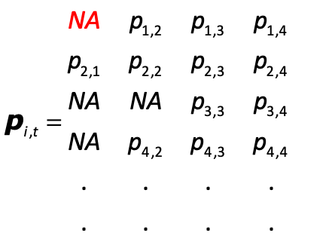
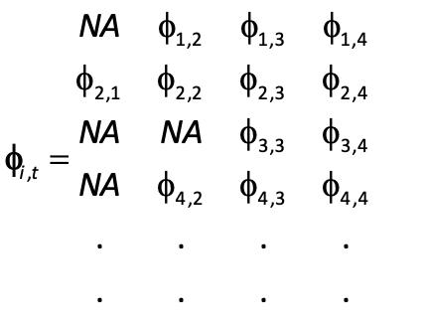
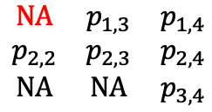
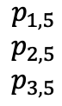
Data
Parameters
$$\begin{matrix}\text{N}\text{A} & p_{1,3} & p_{1,4} \\ p_{2,2} & p_{2,3} & p_{2,4} \\ \text{N}\text{A} & \text{N}\text{A} & p_{3,4}\end{matrix}$$
$$\begin{matrix}p_{1,5} \\ p_{2,5} \\ p_{3,5}\end{matrix}$$
Notes:
23
For the detection process. Remember that in the CJS model we condition upon the first capture, so anything that happens before that doesn‘t count. We don‘t know anything about that time for that specific individual.
A direct consequence is that we consider probabilities of recapture in the CJS model.
Here for individual 1, first capture is at occasion 2. This means that we don‘t have data for this particular individual to estimate p1,2 the recapture prob at occasion 2.

Slide 24
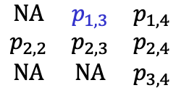
Data
Parameters
$$\begin{matrix}\text{N}\text{A} & p_{1,3} & p_{1,4} \\ p_{2,2} & p_{2,3} & p_{2,4} \\ \text{N}\text{A} & \text{N}\text{A} & p_{3,4}\end{matrix}$$
$$\begin{matrix}p_{1,5} \\ p_{2,5} \\ p_{3,5}\end{matrix}$$
Notes:
24
Then, this individual has information to estimate the recapture prob at time 3 and so on.

Slide 25
Modelling
Notes:
25
The modeling is just usualy GLM modelling
write an equation somewhere:
logit(phi [i,t]) = alpha + beta*temp[t]

Slide 26
Modelling
along time axis
Notes:
26
The modeling is just usualy GLM modelling
write an equation somewhere:
logit(phi [i,t]) = alpha + beta*temp[t]

Slide 27
Modelling
along time axis
along individual axis
Notes:
27
The modeling is just usualy GLM modelling
write an equation somewhere:
logit(phi [i,t]) = alpha + beta*temp[t]

Slide 28
Modelling
along time axis
Time axis:
temporal variation (fixed, random)
temporal covariates
time-constant
Individual axis:
groups (fixed, random)
individual covariates
along individual axis
Notes:
28
The modeling is just usualy GLM modelling
write an equation somewhere:
logit(phi [i,t]) = alpha + beta*temp[t]

Slide 29
Modelling
along time axis
Time axis:
temporal variation (fixed, random)
temporal covariates
time-constant
Individual axis:
groups (fixed, random)
individual covariates
along individual axis
Interaction of time and individual axes:
age effect (time since first capture)
additive effects (group + time)
cohort effects
trap-response
transience
Notes:
29
The modeling is just usualy GLM modelling
write an equation somewhere:
logit(phi [i,t]) = alpha + beta*temp[t]

Slide 30
Modelling
along time axis
Time axis:
temporal variation (fixed, random)
temporal covariates
time-constant
Individual axis:
groups (fixed, random)
individual covariates
along individual axis
Interaction of time and individual axes:
age effect (time since first capture)
additive effects (group + time)
cohort effects
trap-response
transience
Same story for detectability
Notes:
30
The modeling is just usualy GLM modelling
write an equation somewhere:
logit(phi [i,t]) = alpha + beta*temp[t]

Slide 31
A model with constant parameters: φ(.), p(.)

Slide 32
A model with constant parameters: φ(.), p(.)
# Likelihood
for (i in 1:nind){
# Define latent state at first capture
z[i,f[i]] <- 1
for (t in (f[i]+1):n.occasions){
# State process
z[i,t] ~ dbern(phi * z[i,t-1])
# Observation process
y[i,t] ~ dbern(p * z[i,t])
} #t
} #i

Slide 33
A model with constant parameters: φ(.), p(.)
# Likelihood
for (i in 1:nind){
# Define latent state at first capture
z[i,f[i]] <- 1
for (t in (f[i]+1):n.occasions){
# State process
z[i,t] ~ dbern(phi * z[i,t-1])
# Observation process
y[i,t] ~ dbern(p * z[i,t])
} #t
} #i

Slide 34
A model with constant parameters: φ(.), p(.)
# Likelihood
for (i in 1:nind){
# Define latent state at first capture
z[i,f[i]] <- 1
for (t in (f[i]+1):n.occasions){
# State process
z[i,t] ~ dbern(phi * z[i,t-1])
# Observation process
y[i,t] ~ dbern(p * z[i,t])
} #t
} #i

Slide 35
A model with constant parameters: φ(.), p(.)
# Likelihood
for (i in 1:nind){
# Define latent state at first capture
z[i,f[i]] <- 1
for (t in (f[i]+1):n.occasions){
# State process
z[i,t] ~ dbern(phi * z[i,t-1])
# Observation process
y[i,t] ~ dbern(p * z[i,t])
} #t
} #i

Slide 36
A model with constant parameters: φ(.), p(.)
# Likelihood
for (i in 1:nind){
# Define latent state at first capture
z[i,f[i]] <- 1
for (t in (f[i]+1):n.occasions){
# State process
z[i,t] ~ dbern(phi * z[i,t-1])
# Observation process
y[i,t] ~ dbern(p * z[i,t])
} #t
} #i

Slide 37
A model with constant parameters: φ(.), p(.)
# Likelihood
for (i in 1:nind){
# Define latent state at first capture
z[i,f[i]] <- 1
for (t in (f[i]+1):n.occasions){
# State process
z[i,t] ~ dbern(phi * z[i,t-1])
# Observation process
y[i,t] ~ dbern(p * z[i,t])
} #t
} #i
phi ~ dunif(0,1) # Prior for survival
p ~ dunif(0,1) # Prior for recapture

Slide 38
The Cormack-Jolly-Seber model: φ(t), p(t)

Slide 39
The Cormack-Jolly-Seber model: φ(t), p(t)
# Likelihood
for (i in 1:nind){
# Define latent state at first capture
z[i,f[i]] <- 1
for (t in (f[i]+1):n.occasions){
# State process
z[i,t] ~ dbern(phi[t-1] * z[i,t-1])
# Observation process
y[i,t] ~ dbern(p[t-1] * z[i,t])
} #t
} #i

Slide 40
The Cormack-Jolly-Seber model: φ(t), p(t)
# Likelihood
for (i in 1:nind){
# Define latent state at first capture
z[i,f[i]] <- 1
for (t in (f[i]+1):n.occasions){
# State process
z[i,t] ~ dbern(phi[t-1] * z[i,t-1])
# Observation process
y[i,t] ~ dbern(p[t-1] * z[i,t])
} #t
} #i
for (t in 1:n.occasions){
phi[t] ~ dunif(0,1) # Prior for survival
p[t] ~ dunif(0,1)} # Prior for recapture

Slide 41
A general structure with individual & time dependence
# Likelihood
for (i in 1:nind){
# Define latent state at first capture
z[i,f[i]] <- 1
for (t in (f[i]+1):n.occasions){
# State process
z[i,t] ~ dbern(phi[i,t-1] * z[i,t-1])
# Observation process
y[i,t] ~ dbern(p[i,t-1] * z[i,t])
} #t
} #i

Slide 42
A general structure with individual & time dependence
# Likelihood
for (i in 1:nind){
# Define latent state at first capture
z[i,f[i]] <- 1
for (t in (f[i]+1):n.occasions){
# State process
z[i,t] ~ dbern(phi[i,t-1] * z[i,t-1])
# Observation process
y[i,t] ~ dbern(p[i,t-1] * z[i,t])
} #t
} #i

Slide 43

Build simpler models from this general structure

Slide 44
Build simpler models from this general structure
Note: Same idea in, e.g., MARK, unmarked and E-SURGE

Slide 45
Same likelihood structure
# Likelihood
for (i in 1:nind){
# Define latent state at first capture
z[i,f[i]] <- 1
for (t in (f[i]+1):n.occasions){
# State process
z[i,t] ~ dbern(phi[i,t-1] * z[i,t-1])
# Observation process
y[i,t] ~ dbern(p[i,t-1] * z[i,t])
} #t
} #i

Slide 46
Apply constraints on parameters
# Likelihood
for (i in 1:nind){
# Define latent state at first capture
z[i,f[i]] <- 1
for (t in (f[i]+1):n.occasions){
# State process
z[i,t] ~ dbern(phi[i,t-1] * z[i,t-1])
# Observation process
y[i,t] ~ dbern(p[i,t-1] * z[i,t])
} #t
} #i
Example for φ(.), p(.):
# Priors and constraints
for (i in 1:nind){
for (t in 1:(n.occasions-1)){
phi[i,t] <- mean.phi
p[i,t] <- mean.p
} #t
} #i

Slide 47
Apply constraints on parameters
# Likelihood
for (i in 1:nind){
# Define latent state at first capture
z[i,f[i]] <- 1
for (t in (f[i]+1):n.occasions){
# State process
z[i,t] ~ dbern(phi[i,t-1] * z[i,t-1])
# Observation process
y[i,t] ~ dbern(p[i,t-1] * z[i,t])
} #t
} #i
Example for φ(.), p(.):
# Priors and constraints
for (i in 1:nind){
for (t in 1:(n.occasions-1)){
phi[i,t] <- mean.phi
p[i,t] <- mean.p
} #t
} #i
mean.phi ~ dunif(0,1) # Prior mean surv
mean.p ~ dunif(0,1) # Prior mean recap

Slide 48
Exercise 1

Slide 49
What does survival actually mean in capture-recapture ?
Survival refers to the study area

Slide 50
What does survival actually mean in capture-recapture ?
Survival refers to the study area
Mortality and permanent emigration are confounded

Slide 51
What does survival actually mean in capture-recapture ?
Survival refers to the study area
Mortality and permanent emigration are confounded
Therefore we estimate apparent survival, not true survival

Slide 52
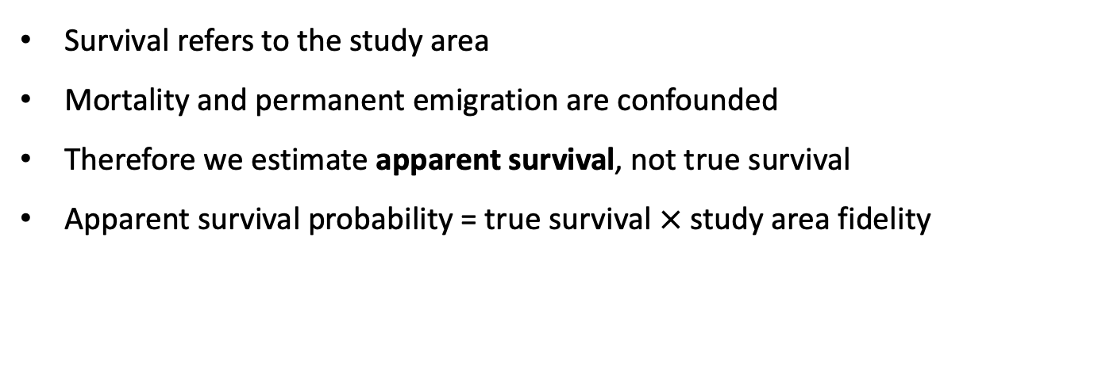
What does survival actually mean in capture-recapture ?
Survival refers to the study area
Mortality and permanent emigration are confounded
Therefore we estimate apparent survival, not true survival
Apparent survival probability = true survival $×$ study area fidelity

Slide 53
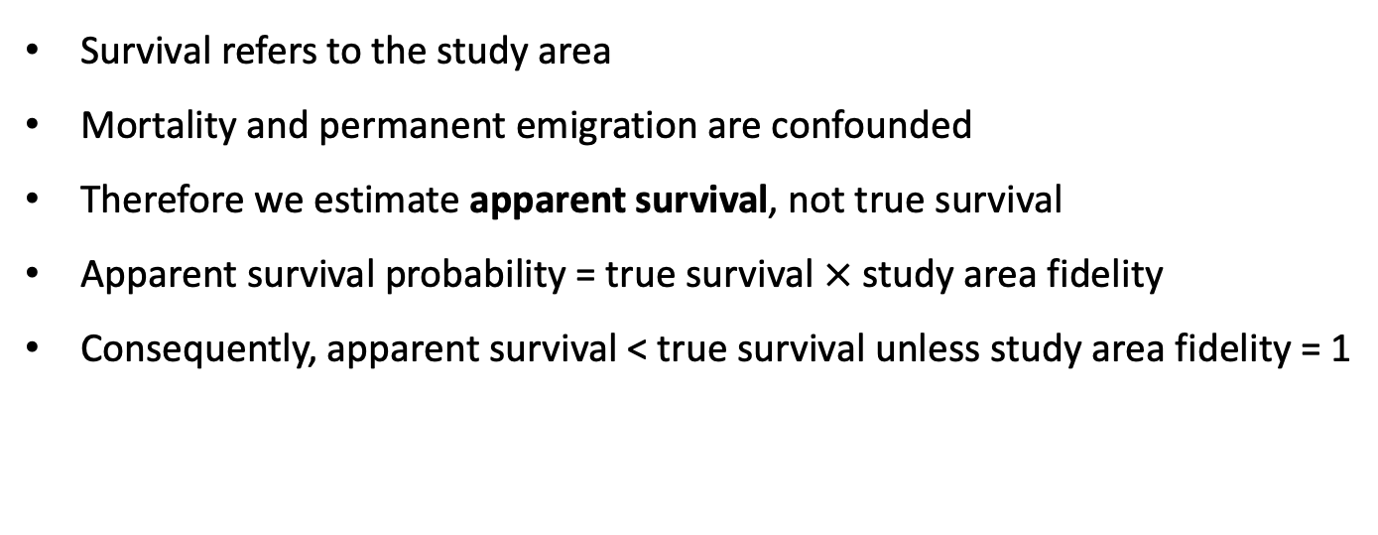
What does survival actually mean in capture-recapture ?
Survival refers to the study area
Mortality and permanent emigration are confounded
Therefore we estimate apparent survival, not true survival
Apparent survival probability = true survival $×$ study area fidelity
Consequently, apparent survival < true survival unless study area fidelity = 1

Slide 54
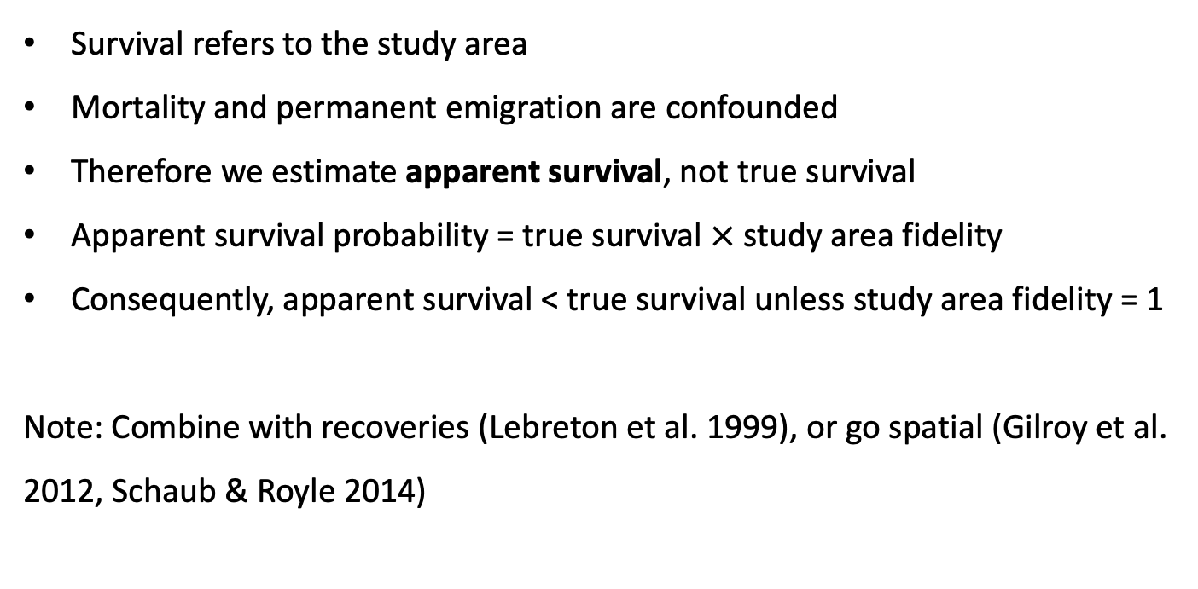
What does survival actually mean in capture-recapture ?
Survival refers to the study area
Mortality and permanent emigration are confounded
Therefore we estimate apparent survival, not true survival
Apparent survival probability = true survival $×$ study area fidelity
Consequently, apparent survival < true survival unless study area fidelity = 1
Note: Combine with recoveries (Lebreton et al. 1999), or go spatial (Gilroy et al. 2012, Schaub & Royle 2014)

Slide 55
Capture-recapture models rely on assumptions
Design
No mark lost
Identity of individuals recorded without error (no false positives)
Captured individuals are a random sample

Slide 56
Capture-recapture models rely on assumptions
Design
No mark lost
Identity of individuals recorded without error (no false positives)
Captured individuals are a random sample
Model
Homogeneity of survival and recapture probabilities

Slide 57
Capture-recapture models rely on assumptions
Design
No mark lost
Identity of individuals recorded without error (no false positives)
Captured individuals are a random sample
Model
Homogeneity of survival and recapture probabilities
Independence between individuals (overdispersion)

Slide 58
Capture-recapture models rely on assumptions
Design
No mark lost
Identity of individuals recorded without error (no false positives)
Captured individuals are a random sample
Model
Homogeneity of survival and recapture probabilities
Independence between individuals (overdispersion)
Note: Use goodness-of-fit tests to assess assumptions (Pradel et al. 2005)

Slide 59
Embrace heterogeneity!
Notes:
logit(phi [i,t]) = alpha + beta*temp[t]

Slide 60
Embrace heterogeneity!
Temporal heterogeneity
Fixed effect phi[i,t] <- alpha[t]
Random effect logit(phi[i,t]) <- mu + epsilon[t]
epsilon[t] ~ dnorm(0, tau)
Covariate logit(phi[i,t]) <- beta[1] + beta[2] * x[t]
Individual heterogeneity
Sex effect logit(phi[i,t]) <- alpha[group[i]]
with group[i] = 1 if i is female, group[i] = 2 otherwise
Continuous covariate logit(phi[i,t]) <- beta[1] + beta[2] * x[i]
Random effect logit(phi[i,t]) <- mu + epsilon[i]
with epsilon[i] ~ dnorm(0, tau)
Notes:
logit(phi [i,t]) = alpha + beta*temp[t]

Slide 61
Embrace heterogeneity!
Temporal heterogeneity
Fixed effect phi[i,t] <- alpha[t]
Notes:
logit(phi [i,t]) = alpha + beta*temp[t]

Slide 62
Embrace heterogeneity!
Temporal heterogeneity
Fixed effect phi[i,t] <- alpha[t]
Random effect logit(phi[i,t]) <- mu + epsilon[t]
epsilon[t] ~ dnorm(0, tau)
Notes:
logit(phi [i,t]) = alpha + beta*temp[t]

Slide 63
Embrace heterogeneity!
Temporal heterogeneity
Fixed effect phi[i,t] <- alpha[t]
Random effect logit(phi[i,t]) <- mu + epsilon[t]
epsilon[t] ~ dnorm(0, tau)
Covariate logit(phi[i,t]) <- beta[1] + beta[2] * x[t]
Notes:
logit(phi [i,t]) = alpha + beta*temp[t]

Slide 64
Embrace heterogeneity!
Temporal heterogeneity
Fixed effect phi[i,t] <- alpha[t]
Random effect logit(phi[i,t]) <- mu + epsilon[t]
epsilon[t] ~ dnorm(0, tau)
Covariate logit(phi[i,t]) <- beta[1] + beta[2] * x[t]
Individual heterogeneity
Sex effect logit(phi[i,t]) <- alpha[group[i]]
with group[i] = 1 if i is female, group[i] = 2 otherwise
Notes:
logit(phi [i,t]) = alpha + beta*temp[t]

Slide 65
Embrace heterogeneity!
Temporal heterogeneity
Fixed effect phi[i,t] <- alpha[t]
Random effect logit(phi[i,t]) <- mu + epsilon[t]
epsilon[t] ~ dnorm(0, tau)
Covariate logit(phi[i,t]) <- beta[1] + beta[2] * x[t]
Individual heterogeneity
Sex effect logit(phi[i,t]) <- alpha[group[i]]
with group[i] = 1 if i is female, group[i] = 2 otherwise
Continuous covariate logit(phi[i,t]) <- beta[1] + beta[2] * x[i]
Notes:
logit(phi [i,t]) = alpha + beta*temp[t]

Slide 66
Embrace heterogeneity!
Temporal heterogeneity
Fixed effect phi[i,t] <- alpha[t]
Random effect logit(phi[i,t]) <- mu + epsilon[t]
epsilon[t] ~ dnorm(0, tau)
Covariate logit(phi[i,t]) <- beta[1] + beta[2] * x[t]
Individual heterogeneity
Sex effect logit(phi[i,t]) <- alpha[group[i]]
with group[i] = 1 if i is female, group[i] = 2 otherwise
Continuous covariate logit(phi[i,t]) <- beta[1] + beta[2] * x[i]
Random effect logit(phi[i,t]) <- mu + epsilon[i]
with epsilon[i] ~ dnorm(0, tau)
Notes:
logit(phi [i,t]) = alpha + beta*temp[t]

Slide 67
Embrace heterogeneity!
Both temporal and individual heterogeneity
Notes:
logit(phi [i,t]) = alpha + beta*temp[t]

Slide 68
Embrace heterogeneity!
Both temporal and individual heterogeneity
Age effect: logit(phi[i,t]) <- alpha[age[i,t]]
with age[i,t] = 1 if individual i is young, age[i] = 2 if adult
Notes:
logit(phi [i,t]) = alpha + beta*temp[t]

Slide 69
Embrace heterogeneity!
Both temporal and individual heterogeneity
Age effect: logit(phi[i,t]) <- alpha[age[i,t]]
with age[i,t] = 1 if individual i is young, age[i] = 2 if adult
Note: In capture-recapture, age corresponds to time elapsed since first encounter. Thus, age in capture-recapture models is true age only for individuals marked at birth.
Notes:
logit(phi [i,t]) = alpha + beta*temp[t]

Slide 70
Embrace heterogeneity!
Both temporal and individual heterogeneity
Age effect: logit(phi[i,t]) <- alpha[age[i,t]]
with age[i,t] = 1 if individual i is young, age[i] = 2 if adult
Covariate logit(phi[i,t]) <- beta[1] + beta[2] * x[i,t]
Notes:
logit(phi [i,t]) = alpha + beta*temp[t]

Slide 71
Embrace heterogeneity!
Both temporal and individual heterogeneity
Age effect: logit(phi[i,t]) <- alpha[age[i,t]]
with age[i,t] = 1 if individual i is young, age[i] = 2 if adult
Covariate logit(phi[i,t]) <- beta[1] + beta[2] * x[i,t]
Note: We need to know the value of covariate at every occasion, even when an individual is not recaptured. If it is not the case, we have missing value(s). The Bayesian framework is useful here, as we can consider a model for the covariate, and fill in the gaps.
Bonner & Schwarz 2006
Notes:
logit(phi [i,t]) = alpha + beta*temp[t]

Slide 72
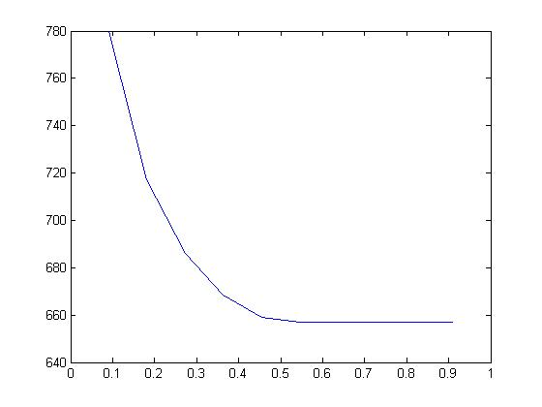
Parameter identifiability: CJS model example
deviance
last φ

Slide 73
Parameter identifiability: CJS model example
deviance
last φ | Dev
0.73 | 656.95
0.59 | 656.95
0.53 | 656.95
0.35 | 670.27
+
+
+
+
last φ

Slide 74
Parameter identifiability
Intrinsic non-identifiability
Likelihood can be expressed by a smaller number of parameters
Feature of the model

Slide 75
Parameter identifiability
Intrinsic non-identifiability
Likelihood can be expressed by a smaller number of parameters
Feature of the model
Extrinsic non-identifiability
Model structure is fine
But lack of data makes a parameter non-estimable
Feature of the data

Slide 76

Parameter identifiability
Intrinsic non-identifiability
Likelihood can be expressed by a smaller number of parameters
Feature of the model
Extrinsic non-identifiability
Model structure is fine
But lack of data makes a parameter non-estimable
Feature of the data

Slide 77
Parameter identifiability in a Bayesian framework?

Slide 78
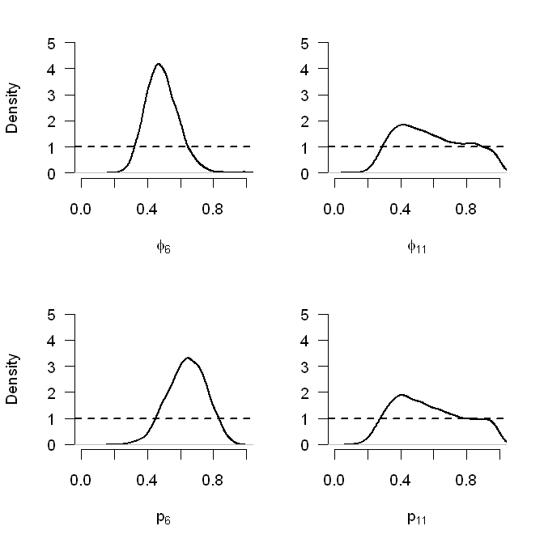
Parameter identifiability in a Bayesian framework?
CJS model (φ_{t}, p_{t}) with 12 years and uniform priors

Slide 79
Parameter identifiability in a Bayesian framework?
Compare prior and posterior
Prior knowledge can be used to make parameters identifiable
CJS model (φ_{t}, p_{t}) with 12 years and uniform priors

Slide 80
Exercise 2

Slide 81
Bonus

Slide 82
Jolly-Seber model
The CJS model is conditional on first capture
0 0 0 1 0 1 0 0 0

Slide 83
Jolly-Seber model
The CJS model is conditional on first capture
conditional
0 0 0 1 0 1 0 0 0

Slide 84
Jolly-Seber model
The CJS model is conditional on first capture
The Jolly-Seber model is unconditional
Estimation of recruitment and population size is possible
Requires an additional assumption (capture = recapture)
See chapter 10 in BPA book
conditional
0 0 0 1 0 1 0 0 0
unconditional

Slide 85
Multinomial model for capture-recapture data
From the capture-histories to the m-array data format
Capture histories
1 0 1 0
1 1 0 0
1 0 1 1
0 1 0 0
m-array
Recapture occ.
Release occ. 2 3 4 Never recaptured
1
2 -
3 - -

Slide 86
Multinomial model for capture-recapture data
From the capture-histories to the m-array data format
Capture histories
1 0 1 0
1 1 0 0
1 0 1 1
0 1 0 0
m-array
Recapture occ.
Release occ. 2 3 4 Never recaptured
1 1
2 -
3 - - 1

Slide 87
Multinomial model for capture-recapture data
From the capture-histories to the m-array data format
Capture histories
1 0 1 0
1 1 0 0
1 0 1 1
0 1 0 0
m-array
Recapture occ.
Release occ. 2 3 4 Never recaptured
1 1 1
2 - 1
3 - - 1

Slide 88
Multinomial model for capture-recapture data
From the capture-histories to the m-array data format
Capture histories
1 0 1 0
1 1 0 0
1 0 1 1
0 1 0 0
m-array
Recapture occ.
Release occ. 2 3 4 Never recaptured
1 1 1+1
2 - 1
3 - - 1 1

Slide 89
Multinomial model for capture-recapture data
From the capture-histories to the m-array data format
Capture histories
1 0 1 0
1 1 0 0
1 0 1 1
0 1 0 0
m-array
Recapture occ.
Release occ. 2 3 4 Never recaptured
1 1 1+1
2 - 1+1
3 - - 1 1

Slide 90
Multinomial model for capture-recapture data
From the capture-histories to the m-array data format
Capture histories
1 0 1 0
1 1 0 0
1 0 1 1
0 1 0 0
m-array
Recapture occ.
Release occ. 2 3 4 Never recaptured
1 1 2 0 0
2 - 0 0 2
3 - - 1 1

Slide 91
Multinomial model for capture-recapture data
Cell probabilities of the m-array:
Recapture occ.
Rel. 2 3 4 Never
φ₁p₁ φ₁(1-p₁)φ₂p₂ φ₁(1-p₁)φ₂(1-p₂)φ₃p₃ 1-Σ₁
- φ₂p₂ φ₂(1-p₂)φ₃p₃ 1-Σ₂
3 - - φ₃p₃ 1-Σ₃
Likelihood of the m-array:
where
m_{t} = t^{th} row of m-array
q_{t} = cell probabilities of the m-array for release occasion t
R_{t} = number of released individuals at occasion t

Slide 92
Bayesian GOF: Posterior predictive check (PPC)
Several Bayesian GOF are possible (reviewed by Conn et al. 2018)
Here we use a general and very common Bayesian model-checking procedure, the posterior predictive check
In a nutshell:
Quantify how different the observed data is compared to what we expect from the estimated parameters [measure of discrepancy]
To assess how “bad” or “good” that difference is, compare to the same measure of discrepancy obtained for ideal data simulated from the estimated parameters
This double comparison is done for each sample of the MCMC chains
Generally straightforward to implement in BUGS or in R after the analysis (from the MCMC chains)

Slide 93
Bayesian GOF: Posterior predictive check (PPC)
Basic algorithm:
At each MCMC iteration 𝑡:
Calculate a discrepancy statistic 𝐷(𝑥;𝑒_{𝑡}) to measure some “distance” between the observed data 𝒙 and the corresponding expected values, 𝑒_{𝑡} at that iteration (based on the MCMC chain values of the parameters)
Generate a new data set 𝑥_{𝑡} from the fitted model (using the MCMC chain value of the parameters)
Calculate a discrepancy statistic 𝐷(𝑥_{𝑡};𝑒_{𝑡}) to measure the “distance” between the simulated data 𝒙_{𝒕} and the corresponding expected values, 𝑒_{𝑡} at that iteration

Slide 94
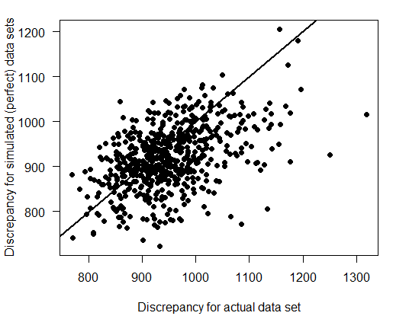
Bayesian GOF: Posterior predictive check (PPC)
Then, use the values of 𝐷(𝑥; 𝑒_{𝑡}) and 𝐷(𝑥_{𝑡}; 𝑒_{𝑡}) to check the fit…
1) ...graphically: scatterplot of 𝐷(𝑥; 𝑒_{𝑡}) and 𝐷(𝑥_{𝑡}; 𝑒_{𝑡})
No evidence of lack of fit if ~½ points above and
~½ below a 1:1 line
2) …numerically by calculating a Bayesian p-value = proportion of times that 𝐷(𝑥; 𝑒_{𝑡}) < 𝐷(𝑥_{𝑡}; 𝑒_{𝑡})
→ close to 0.5: good fit
→ close to 0 or 1: suggests doubtful fit

Slide 95
Bayesian GOF: Posterior predictive check (PPC)
On what response to define observed and expected values?
• Not on binary responses (i.e. detection histories) themselves
• Use some aggregating: m-array in CR data
What measure of discrepancy?
• Different options, e.g.
– Pearson chi-squared statistic
– Freeman-Tukey statistic
• Different measures sensible to different kinds of lack of fit; resulting P-values may differ substantially
• Normally assess some global measure of lack of fit; can also assess particular features of the model (e.g. extreme values)

Slide 96
Bayesian GOF: Posterior predictive check (PPC)
Implicitly depend on priors
Bayesian P-values have been criticised
They use data twice:
simulate data; compare them to these data
Not clear what values represent a good fit
→ Descriptive only! (not for model selection)

